Slide 1


Green Pace
Security Policy Presentation
Developer: Steven Anderson

Slide 2

OVERVIEW: DEFENSE IN DEPTH
Overview of the threat matrix
Define security principles
Strong coding standards
Data encryption standards
What is AAA?
Unit Testing examples
Recommended Tools
Notes:
Hello, and welcome to this security policy presentation. In this presentation I hope to show you the importance of security in development and usage of programs.

Slide 3
THREATS MATRIX
Likely Likely threats mean that the threat of attack is far more likely to happen | Priority Priority threats are threats that are very exploitable and can have severe repercussions
Low priority Low priority threats will have less exploitable vulnerabilities while possibly also being expensive to fix | Unlikely Unlikely threats are ones that have a low likelihood of occurring

Slide 4
10 PRINCIPLES
Validate Input Data
STD-001-CPP, STD-002-CPP, STD-003-CPP, STD-005-CPP, STD-009-CPP, STD-010-CPP
Heed Compiler Warnings
STD-001-CPP
Architect and Design for Security Policies
STD-003-CPP, STD-004-CPP, STD-005-CPP, STD-006-CPP
Keep it Simple
STD-007-CPP, STD-008-CPP, STD-010-CPP
Default Deny
STD-002-CPP, STD-008-CPP
Adhere to the Principle of Least Privilege
STD-004-CPP
Sanitize Data Sent to Other Systems
STD-004-CPP
Practice Defense in Depth
STD-004-CPP, STD-007-CPP
Use Effective Quality Assurance Techniques
STD-001-CPP, STD-005-CPP, STD-006-CPP, STD-007-CPP, STD-009-CPP
Adopt a Secure Coding Standard
STD-002-CPP, STD-003-CPP

Slide 5
CODING STANDARDS
Data Type
Do not modify the standard namespaces
Data Value
Do not read uninitialized memory
String Correctness
Do not attempt to create a std::string from a null pointer
SQL Injection
Sanitize data passed to complex subsystems
Memory Protection
Do not access freed memory
Assertions
Use a static assertion to test the value of a constant expression
Exceptions
Do not abruptly terminate the program
Declaration and Initialization
Obey the one-definition rule
Containers
Use valid iterator ranges
Expressions
Do not delete an array through a pointer of the incorrect type

Slide 6

ENCRYPTION POLICIES
Encryption At Rest
The form of encryption that protects data while it is stored. Ensures protection of data from being accessed while on a storage medium.
Encryption At Flight
The form of encryption that protects data as it moves. Ensures that data is protects as it is sent from one source to another preventing hijacking while being transmitted.
Encryption In Use
The form of encryption used to protect data while it is being processed and used. Ensuring that data is safe while actively being used. Can be intensive on the system.

Slide 7

TRIPLE-A POLICIES
Authentication
Identifying users on the network and the process of granting them access within the network.
Authorization
Defining access controls to decide who has access to what within the network based on permission and authorization.
Accounting
Monitoring activity within the network. Looking at things such as what they accessed, for how long were they accessing the network and things within it, and sometimes from where did they access the network.

Slide 8
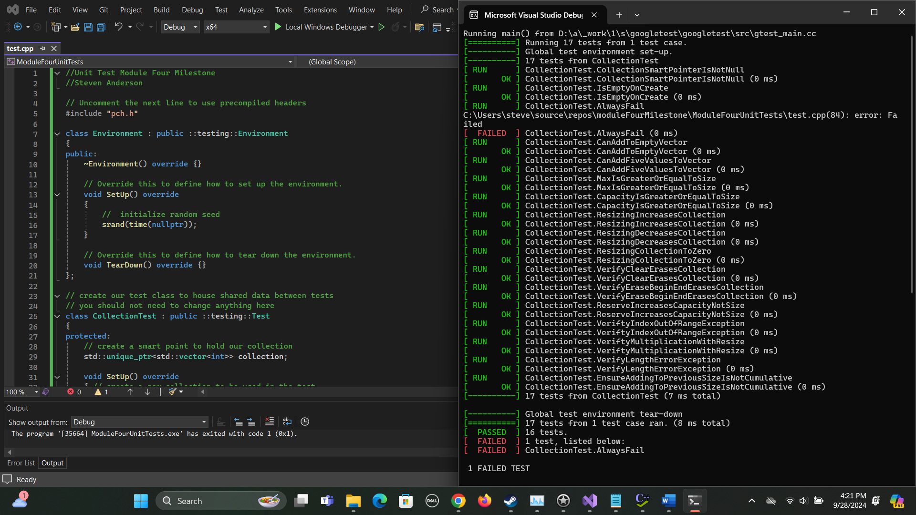
Unit Testing
Unit testing is a useful tool to find a variety of vulnerabilities, poor coding techniques and problems within code.

Slide 9
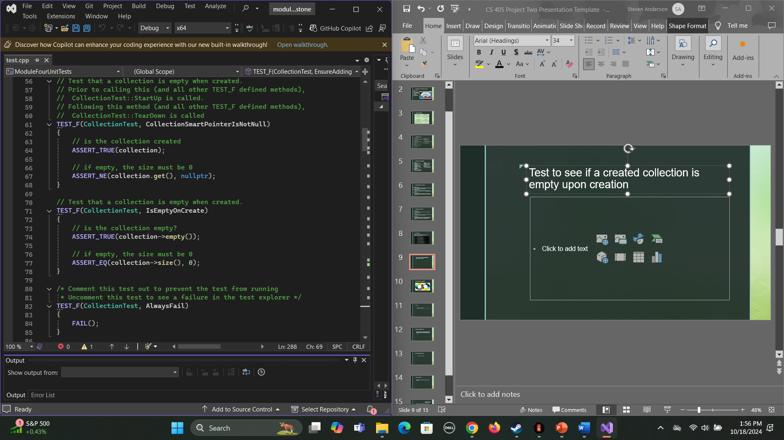
Test to see if a created collection is empty upon creation
This test is using ASSERT_TRUE to ensure that the collection is empty
Then uses ASSERT_EQ if it is empty to ensure that it’s size is Zero

Slide 10
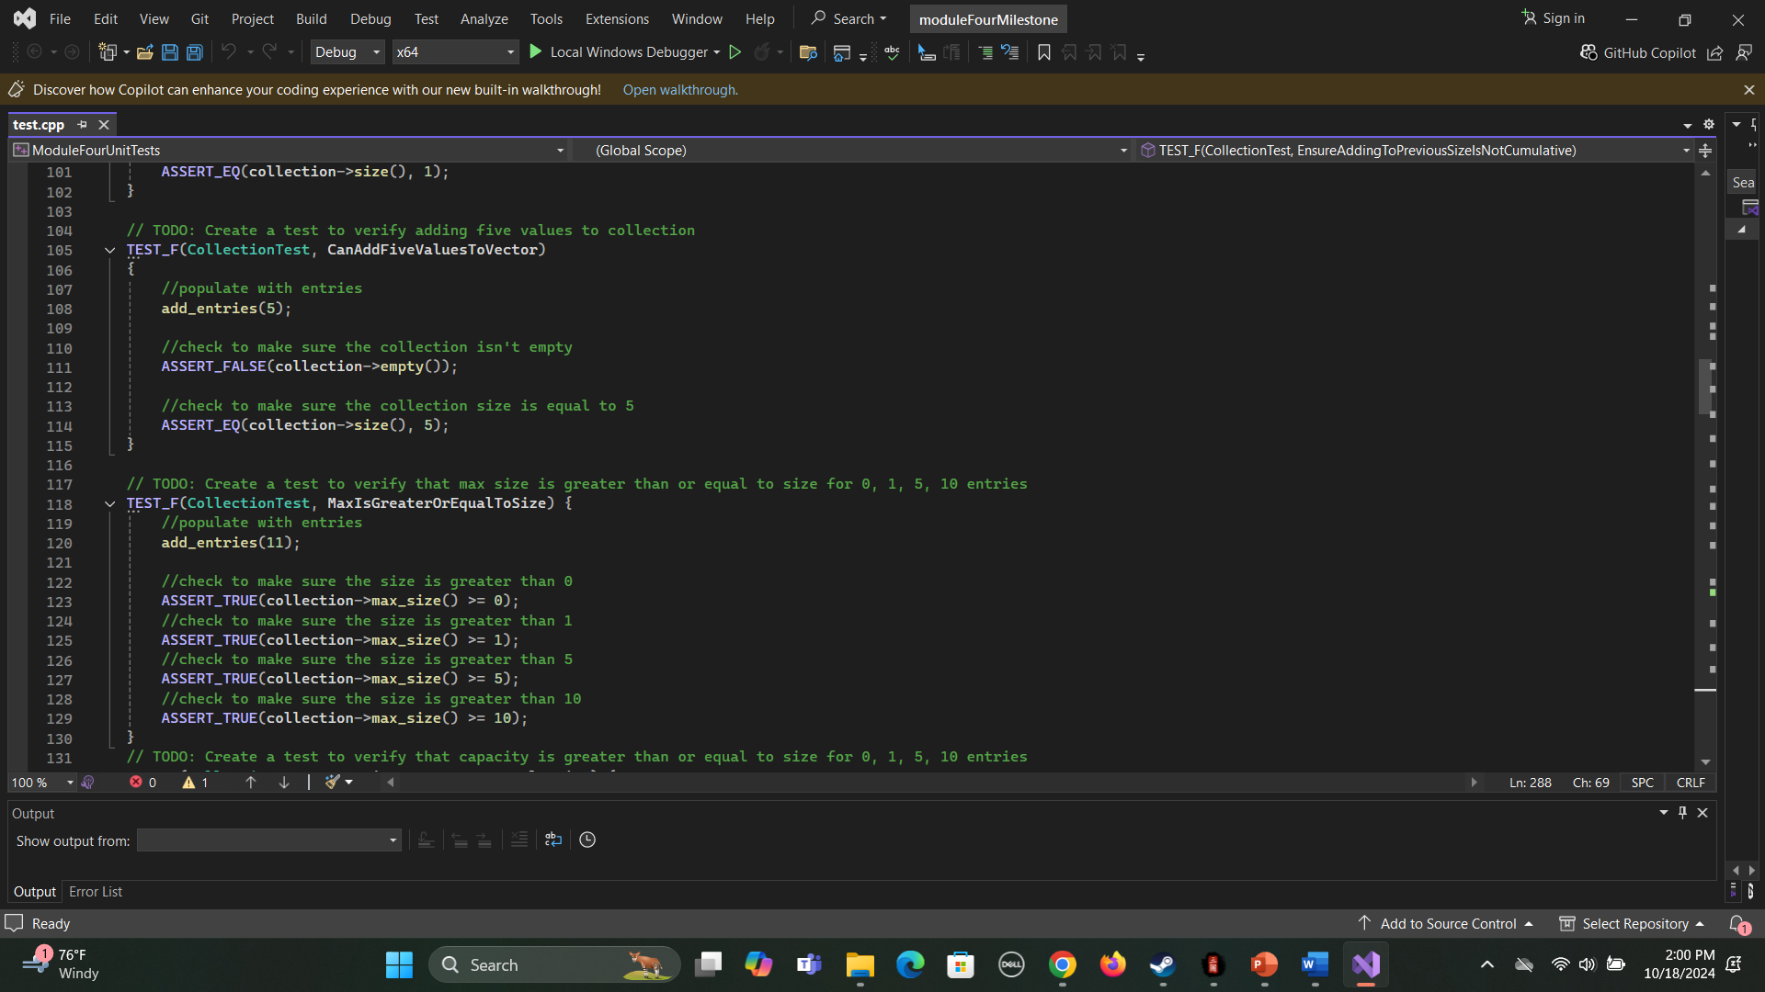
Test to Verify the Max Size is greater than a set value
This test uses a series of ASSERT_TRUE tests to check the size of collection to ensure it is greater than 0 than 1 than 5 and than 10
Useful to prevent assigning values into collection past it’s max size

Slide 11
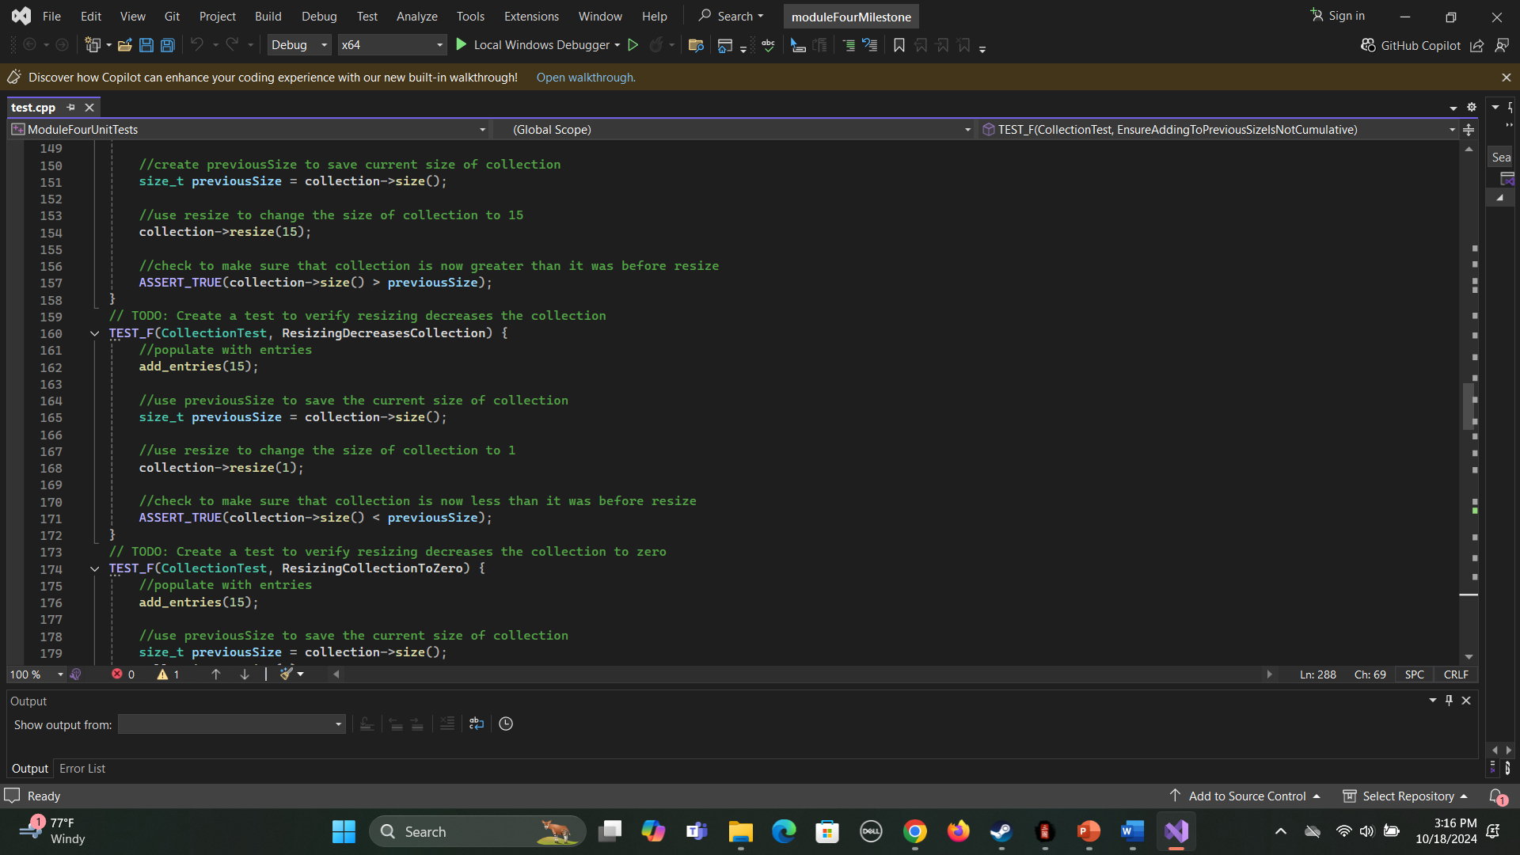
Test to verify that resizing will decrease the collection
This test resizes the collection and then uses ASSERT_TRUE to ensure that the new size is less than the previous original size

Slide 12
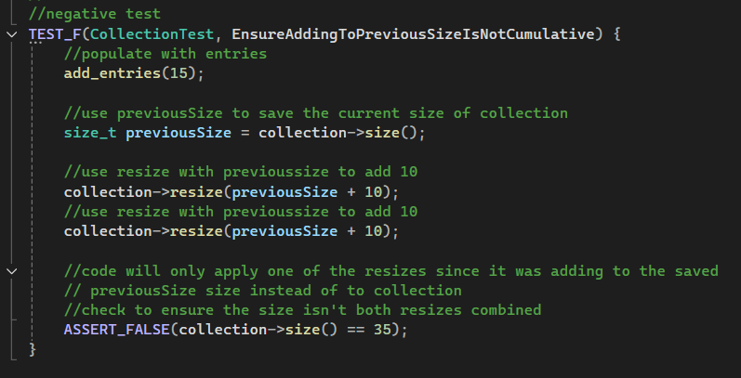
Test the ensure that ASSERT_FALSE will work
This test uses resize to increase the size of previousSize by increments of 10 before using an ASSERT_FALSE check that only checks the collection not to previousSize value

Slide 13

AUTOMATION SUMMARY

Slide 14
TOOLS
The DevSecOps pipeline is the automated process that uses security practices to ensure secure development.
Security controls
Testing
Monitoring
External Tools used within the pipeline
Parasoft C/C++
Used for code testing and verification to find vulnerabilities
SonarQube
Tool used to provide constant inspection of code and monitor security
Veracode
Tool used to analyze the software libraries used within coding framework. Also scans code for any security risks or vulnerabilities and recommends any version updates to deal with security risks

Slide 15
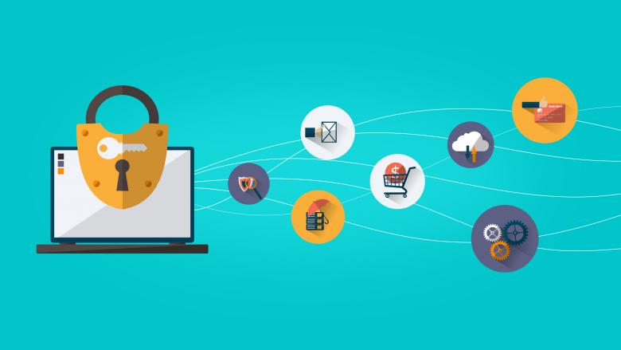
RISKS AND BENEFITS
“Don’t Leave Security to the End”
Development testing
Implement security
System testing
Risks if you don’t
Undetected risks
Without monitoring vulnerabilities can be exploited
Reactionary risk
Reacting to an attack will only stem the attack
Legal risks
Will end up costing more to fix
Quality of code
Product will be better if coded securely

Slide 16
RECOMMENDATIONS
Focus on security
Continue to add new policies and standards as new threats are realized
Document all goals and steps to implementing security
Check for updates on software to prevent vulnerabilities
Follow the coding standards to prevent vulnerabilities and unorganized code
Monitor and test the system routinely to keep it safe
Have a plan in place should an attack happen to mitigate the damage and react fast
Utilize encryption for data
Follow the AAA polices
Make sure the defense is working in a defense in depth model

Slide 17

CONCLUSIONS
Software Security is a constant battle to ensure data protection. With new vulnerabilities being discovered every year and hostile agents always on the look out for unsecured networks.
By ensuring that organizational policy follows the best secure software practices you will mitigate the damage done if not outright prevent attacks. An unsecured network is a better target for hostile agents than a secure network.
Developing with security in mind at every step will ensure all desired security standards are met and incorporated. Don’t try and incorporate all the security policies and standards at the end.

Slide 18
REFERENCES
Yuga. (2024, June 24). What is DevSecOps Pipelines? – Comprehensive Guide. Practical DevSecOps. https://www.practical-devsecops.com/what-is-devsecops-pipelines/
Tigera. (2024, May 5). 16 Amazing DevSecOps Tools to shift your Security left. https://www.tigera.io/learn/guides/devsecops/devsecops-tools/#:~:text=ThreatModeler%20aims%20to%20help%20enterprises%20effectively%20manage,various%20clouds%2C%20including%20AWS%20and%20Microsoft%20Azure.
Martinez, J. (2024, September 27). What is AAA Security? Authentication, Authorization, and Accounting. Strongdm. https://www.strongdm.com/blog/aaa-security
Dinic, M., & Dinic, M. (2024, April 29). Understanding encryption - data at rest, in motion, in use. Jatheon Technologies Inc. https://jatheon.com/blog/data-at-rest-data-in-motion-data-in-use/
OWASP Developer Guide | Principles of Security | OWASP Foundation. (n.d.-b). https://owasp.org/www-project-developer-guide/draft/foundations/security_principles/
SEI External Wiki Home - Homepage - Confluence. (n.d.). https://wiki.sei.cmu.edu/confluence/
Gemini AI. (n.d.). Google.com. https://gemini.google.com/

